Slide 1
Models of the motor system
Spring 2025
Opher Donchin

Slide 2
Part 1
Hick’s law

Slide 3
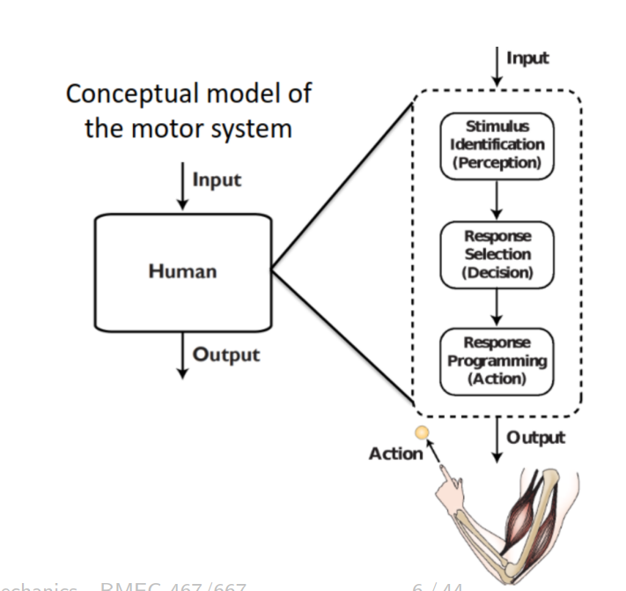
Feedforward motor processing

Slide 4
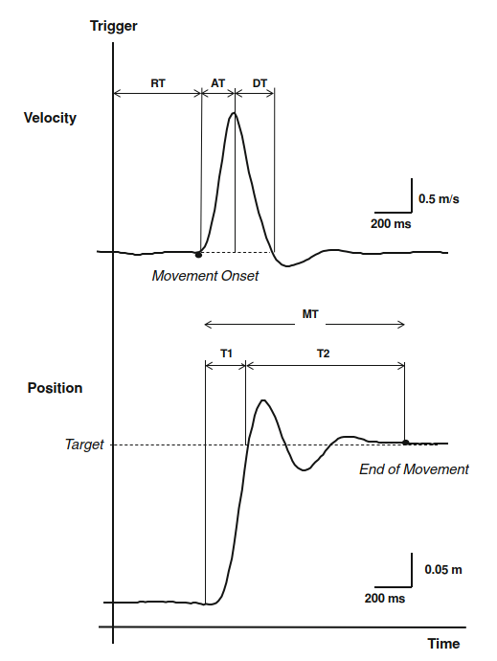
Reaction time
Factors that influence reaction time
Number of choices
Stimulus mode and intensity
Stimulus-response compatibility
Anticipation
Di Lorenzo EBR 2012 doi:10.1007/s00221-012-3318-y

Slide 5
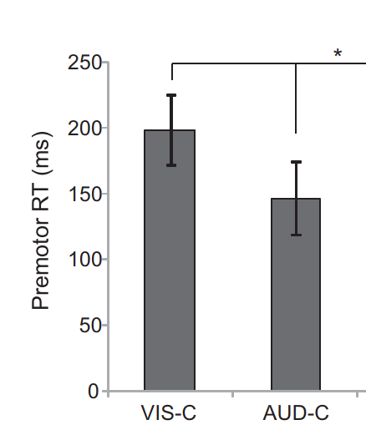
Reaction time
Factors that influence reaction time
Number of choices
Stimulus mode and intensity
Stimulus-response compatibility (demo)
Anticipation
Carlsen Neuroscience Letters 2011 doi:10.1016/j.neulet.2011.06.027

Slide 6
Reaction time
Factors that influence reaction time
Number of choices
Stimulus mode and intensity
Stimulus-response compatibility
Demo
Di Lorenzo EBR 2012 doi:10.1007/s00221-012-3318-y

Slide 7

Reaction time
Factors that influence reaction time
Number of choices
Stimulus mode and intensity
Stimulus-response compatibility (demo)
Anticipation

Slide 8
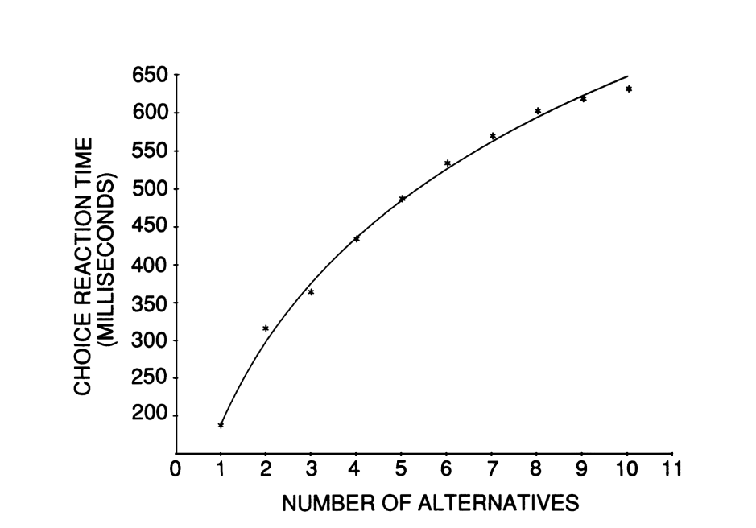
Reaction time increases with number of choices
Data from Merkel PhD Thesis 1885
via: Norwich 2003 Chapter 13 http://www.biopsychology.org/norwich/isp/isp.htm

Slide 9
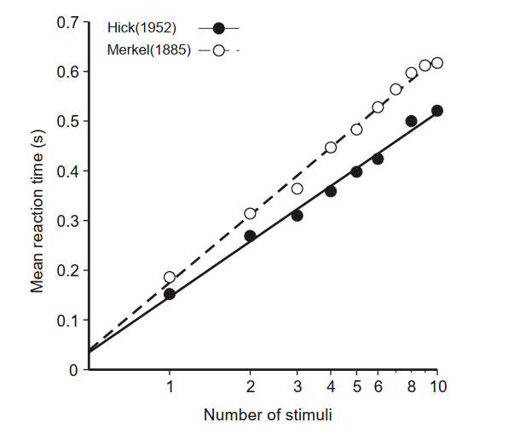
Hick’s law
Laming Entropy 2010 doi:10.3390/e12040720

Slide 10
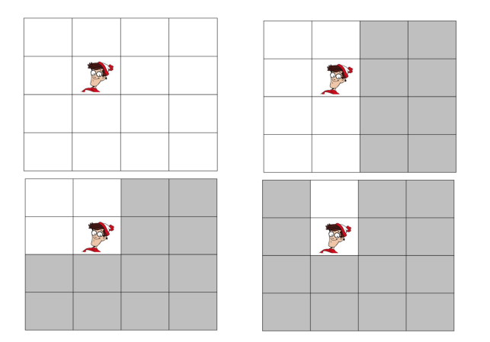

Why $\log_{2}{N}$?
Binary search

Slide 11
Part 2
Fitt’s law

Slide 12
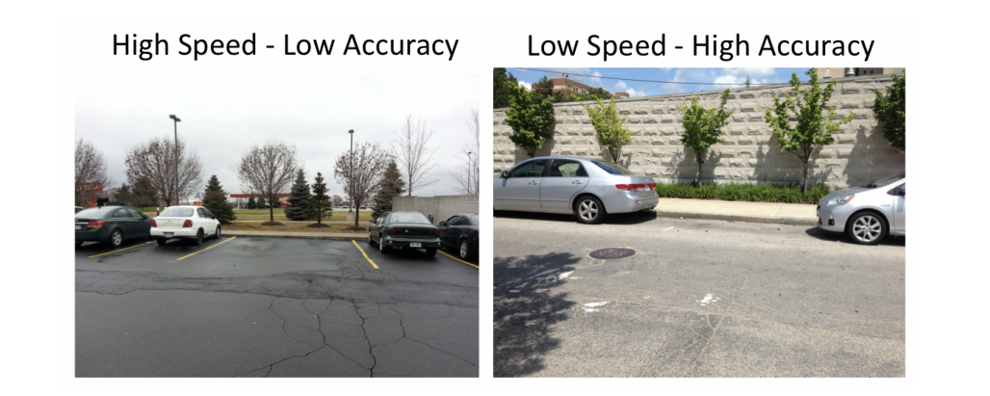
Fitt’s law
Movement time scales with difficulty
Distance
Precision

Slide 13
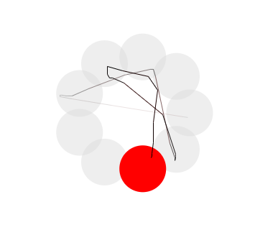
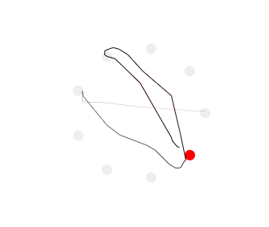
Fitt’s law
Movement time scales with difficulty
Distance
Precision

Slide 14
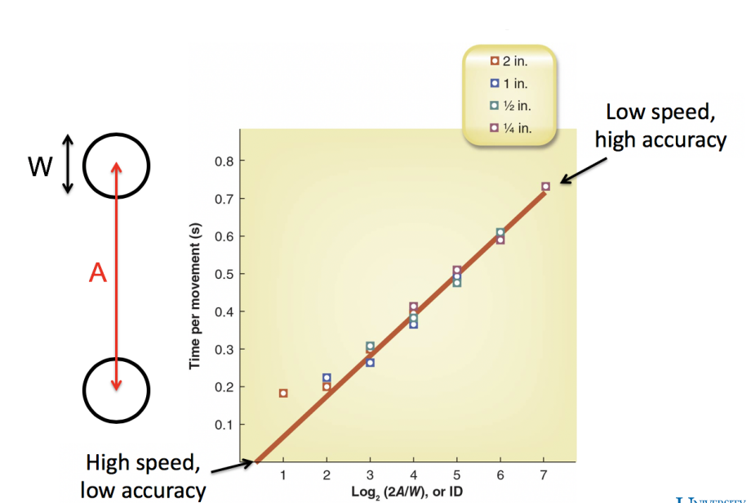
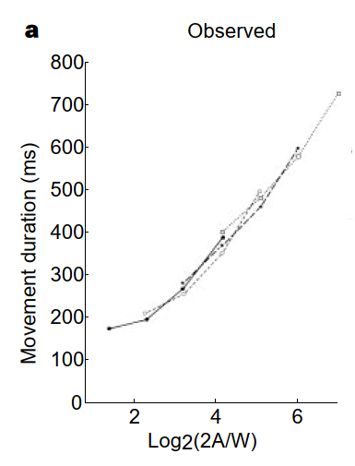
Original Fitt’s data
Fitts J Exp Psych 1954 doi:10.1037/h0055392 via: Schmidt 2011 ISBN: 9781492547754
Harris Nature 1998 doi:10.1038/29528

Slide 15
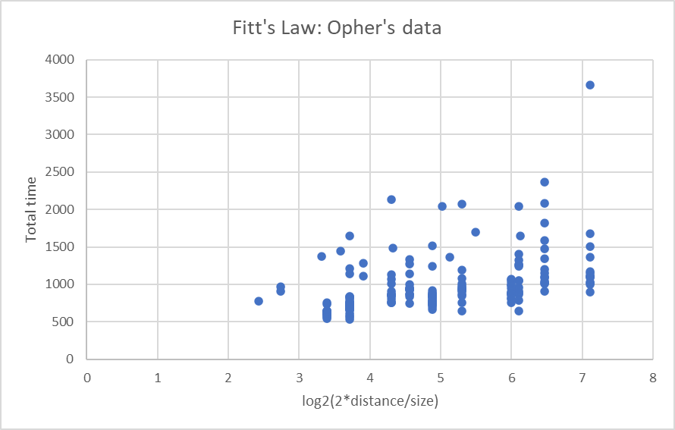
Try Fitt’s law on your own
Many online experiments to try
https://twinji.github.io/fitts-law-input-task/#/

Slide 16
Fitt’s law used in web design
Frequently used areas
Large and central
Reduce time and errors
Infrequently used areas
Small and peripheral
Increased accuracy requirement:
Prevents errors
Costs time

Slide 17
Part 3
The minimal variance principle

Slide 18
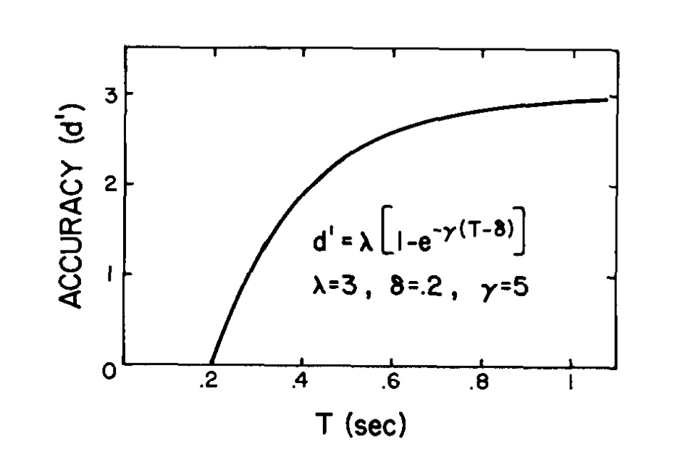

The speed / accuracy tradeoff
Fix distance
Call $1/{target size}$ the accuracy
Wickelgren Acta Psychologica 1977 doi:10.1016/0001-6918(77)90012-9

Slide 19
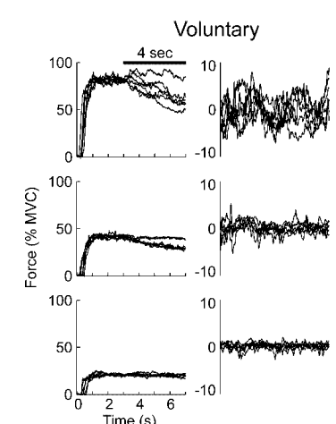
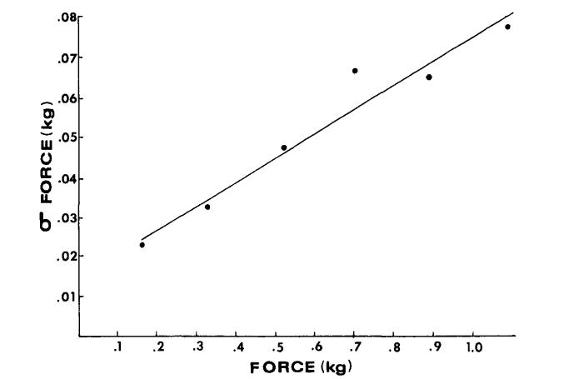
Motor variability scales with motor output
Signal dependent noise
Schmidt Psychological Review 1979 doi:10.1037/0033-295X.86.5.415
Jones J Neurophysiol 2002 doi:10.1152/jn.00985.2001

Slide 20
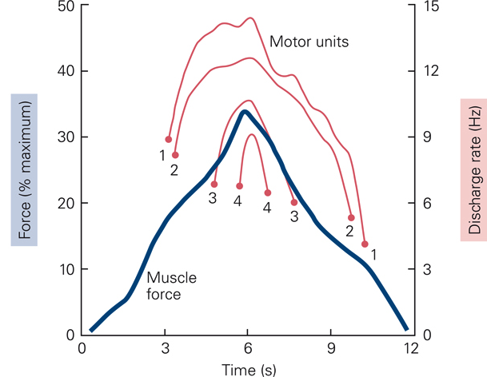
Size principle explains signal dependent noise
Increased force recruits bigger motor units
Bigger motor units have bigger fluctuation

Slide 21
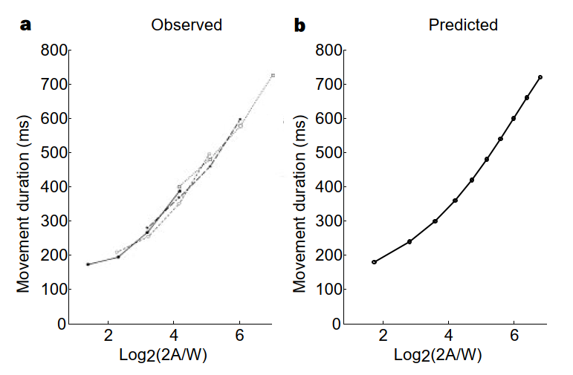
Model: minimize variability
The brain chooses motor commands to minimize motor variability
Given time constraints
Harris Nature 1998 doi:10.1038/29528

Slide 22
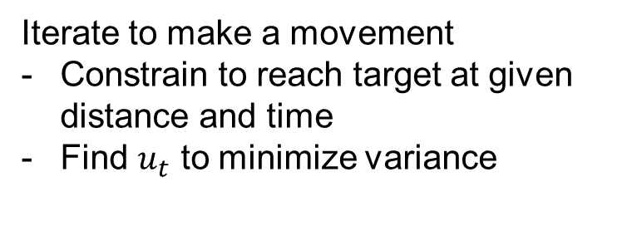
Model of 1-D arm movement
Signal dependent noise
Iterate to make a movement
Constrain to reach target at given distance and time
Find $u_{t}$ to minimize variance
Now find minimum time to achieve given accuracy constraint
Harris Nature 1998 doi:10.1038/29528

Slide 23
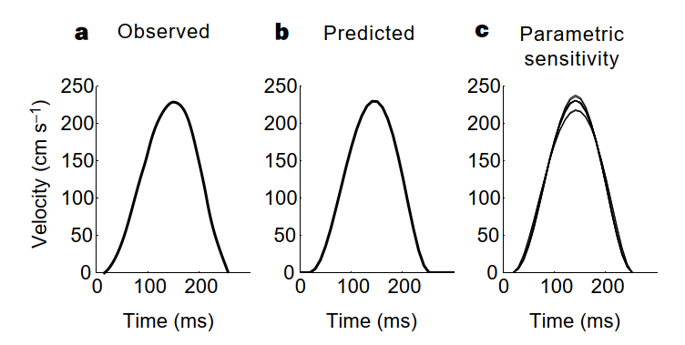
Minimum variance also gives bell shaped profile
Harris Nature 1998 doi:10.1038/29528

Slide 24
Part 4
The minimum jerk trajectory

Slide 25
Minimum jerk is an older idea
Assume movement should be smooth
12 constraints and 12 unknowns
Add constraints:
Flash J Neurosci 1985 doi:10.1523/JNEUROSCI.05-07-01688.1985

Slide 26
Minimum jerk can determine movement shape
Minimum jerk
Movement should be smooth
Flash J Neurosci 1985 doi:10.1523/JNEUROSCI.05-07-01688.1985

Slide 27
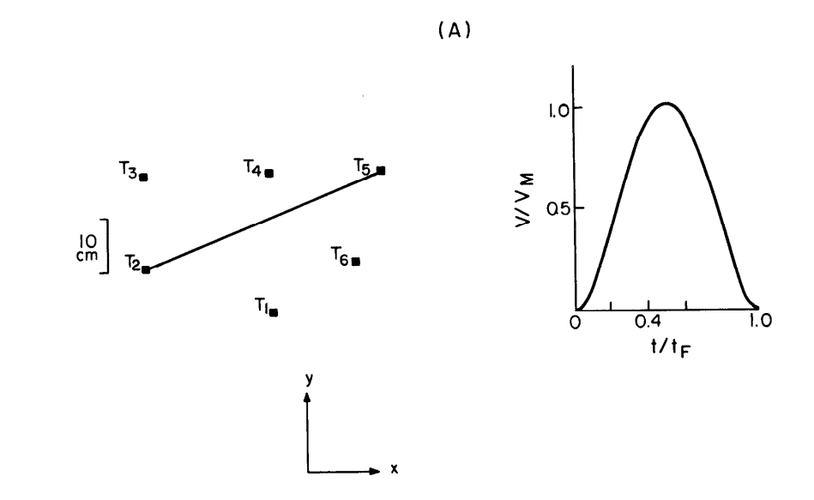
Minimum jerk gives bell shaped trajectory
Flash J Neurosci 1985 doi:10.1523/JNEUROSCI.05-07-01688.1985

Slide 28
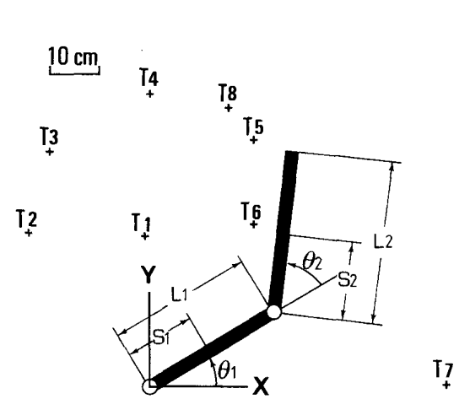
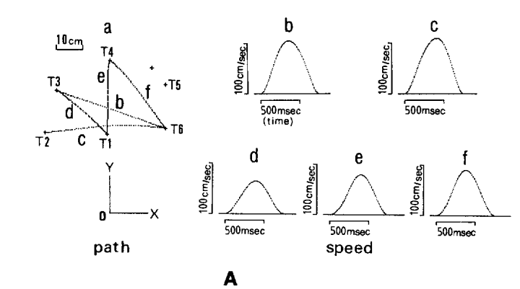
Minimum torque change trajectory
Uno Biological Cybernetics 1989 doi:10.1007/BF00204593

Slide 29
Part 5
The 2/3 power law

Slide 30
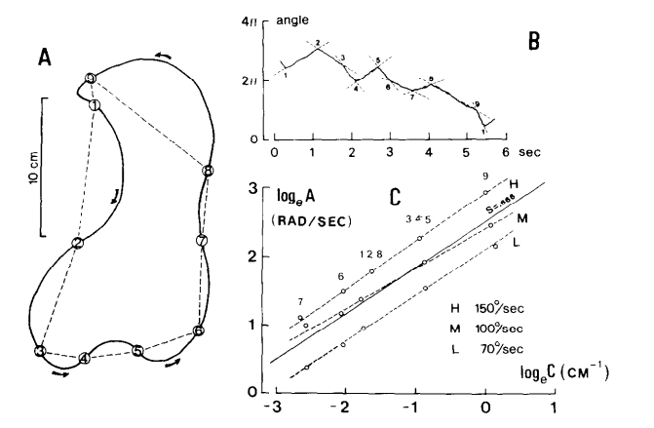
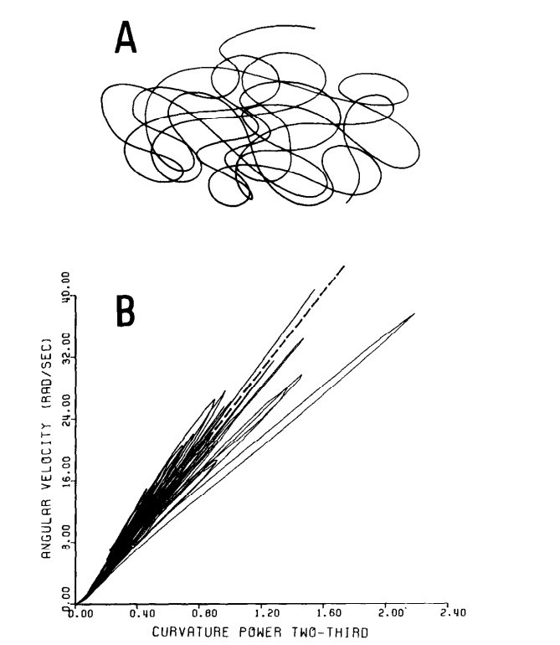
2/3 power law
Lacquiniti Acta Psychologica 1983 doi:10.1016/0001-6918(83)90027-6

Slide 31
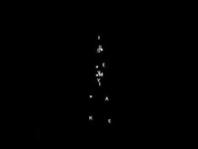
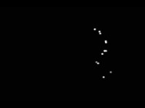
Perception of biological motion

Slide 32
Part 6
The uncontrolled manifold hypothesis

Slide 33
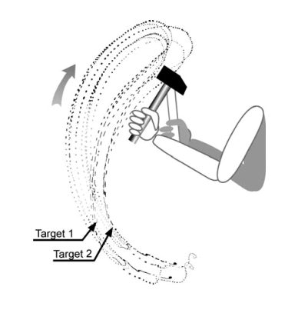
Not all variability is a problem
Down stroke accurate
Return stroke variable
Bernstein 1967 ISBN 9780080119403
via Muller Advances Exp Med Biol 2009 doi:10.1007/978-0-387-77064-2_23

Slide 34
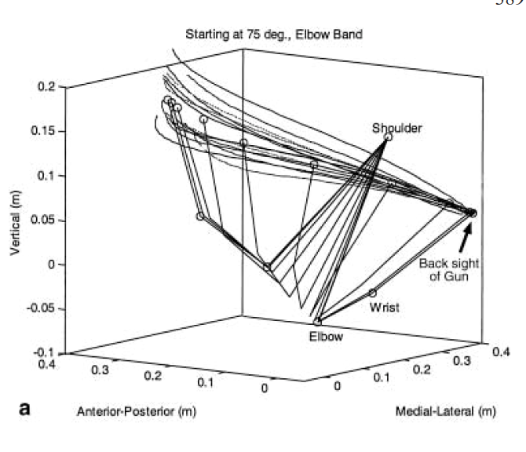
The uncontrolled manifold hypothesis
The nervous does not control variability in dimensions that are not relevant to the task
Sholz EBR 2000 doi:10.1007/s002210000540

Slide 35
In class exercise
Go to the Fitt’s law website:
Collect and save the data
As an excel file
Analyze it
Scaffolding and step by step in structions in the colab

Slide 36


Links
Experiment
Colab
https://twinji.github.io/fitts-law-input-task/#/

